Slide 1
Diabetes Prediction
Data Science Project

Slide 2
Facts
Diabetes is one of deadliest infections on the planet.
Also mayor cause of :
kidney infections
various types of maladies like heart assault
visual deficiency
It isn’t just an ailment yet additionally a maker of various types of maladies like heart assault, visual deficiency, kidney infections, and so on.
One third go undetected in early stage.

Slide 3
Approaches
Machine Learning – The area of artificial intelligence that uses the statistical Data Analyses.
Recognized to be a promising area that can help patient classification regarding the medical conditions.
Many methods have been used so far:
SVM, K Node Neighbors, Naïve Bayes, Neural Networks…
Some Studies have shown:
SVM over performs other algorithms in detecting Diabetes.

Slide 4
Dataset Description
Total entries: 768
No-null value in any columns
All the values are either integer or float
No string values.
Varies in long range.
Link:
https://www.kaggle.com/uciml/pima-indians-diabetes-database
 | mean | std | min | max
Pregnancies | 3.845052 | 3.369578 | 0 | 17
Glucose | 120.894531 | 31.972618 | 0 | 199
BloodPressure | 69.105469 | 19.355807 | 0 | 122
SkinThickness | 20.536458 | 15.952218 | 0 | 99
Insulin | 79.799479 | 115.244002 | 0 | 846
BMI | 31.992578 | 7.88416 | 0 | 67.1
DiabetesPedigreeFunction | 0.471876 | 0.331329 | 0.078 | 2.42
Age | 33.240885 | 11.760232 | 21 | 81
Outcome | 0.348958 | 0.476951 | 0 | 1

Slide 5
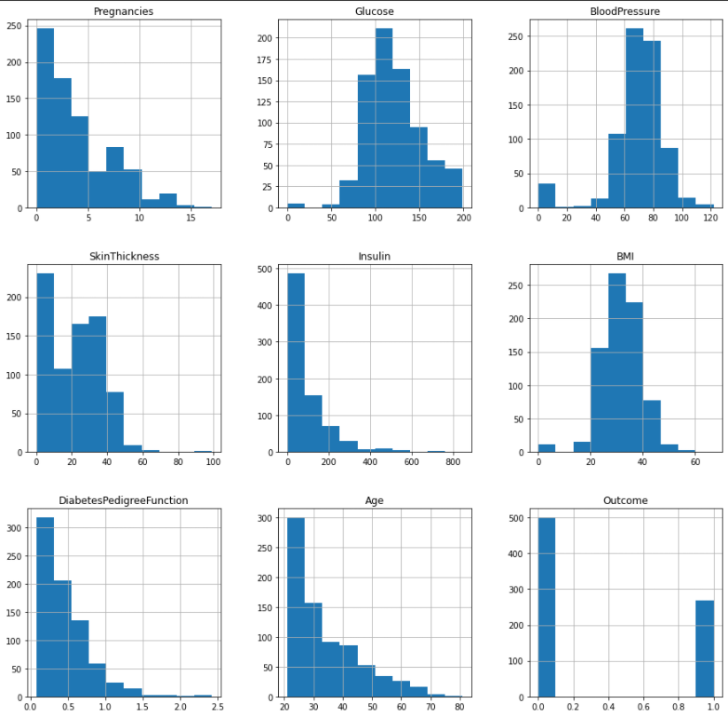
Dataset Visualization Using Histogram

Slide 6

Handling Unbalanced data
In our dataset label count ‘0’ is almost double then label count ‘1’.
It creates biased decision prediction for ‘0’.
To stop that we need to do upsampling.
It creates new data points to balance dataset.
For that we are using “imblearn” library.

Slide 7
Logistic Regression & SVM
Logistic Regression is one of the most popular supervised machine learning algorithms used for predicting categorical dependent variable using a given set of independent variables.
SVM is a classification model which basically is a representation of different classes in a hyperplane in multidimensional space.
SVM creates classifier by maximizing the margin between classes and placing hyper plane classifier between support vectors.

Slide 8
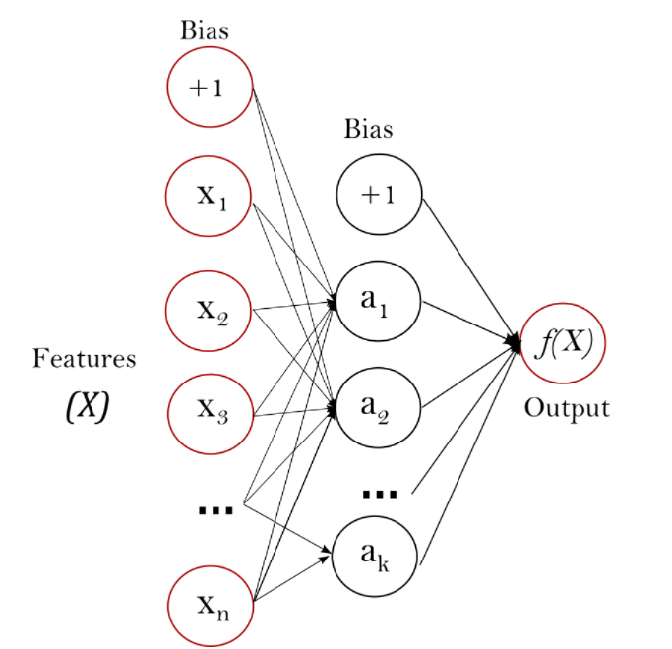
Multi-layer Perceptron
Multi-layer Perceptron (MLP) is a class of feedforward artificial neural network (ANN).
MLP is a supervised learning algorithm that learns a function
f(.) : R^{m} → Rº
by training on a dataset,
Where,
m = the number of dimensions for input
o = is the number of dimensions for output.
This model optimizes the log-loss function using LBFGS or stochastic gradient descent.

Slide 9
Results
Model | Accuracy | CV Accuracy
KNN | 0.766234 | 0.759096
Decision Tree | 0.681818 | 0.681068
Random Forest | 0.759740 | 0.760973
Logistic Regression | 0.746753 | 0.762533
Gaussian NB | 0.720779 | 0.749524
SVC | 0.766234 | 0.762533
MLP Classifier | 0.753247 | 0.765812
Here looking at accuracy score of model by simple train and test sets, MLP Classifier performed good.
But after getting cross validation accuracy Logistic Regression, SVC and MLP Classifier are better choice for this dataset as they have almost same accuracy.

Slide 10
Advantages
User can search for doctor’s help at any point of time.
User can diagnose their diabetes and get instant result.
Doctors get more clients online.
Getting results from lab takes much time. Using model by giving information model predicts then and there.
Disease can be detected in early stage.
Disadvantages
The system is not fully automated, it needs data from user for full diagnosis.
Because there could be fault in training data, It is preferable to consult with professional.

Slide 11
Thank You

